Slide 1


Slide 2
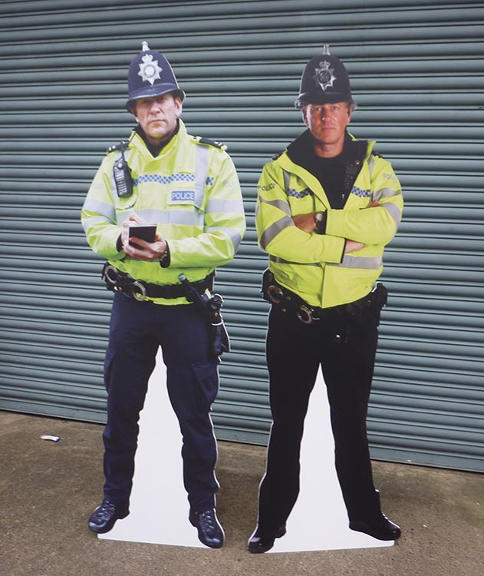



Disclaimer
Don’t do illegal shit

Slide 3
OSINT
Open Source Intelligence (OSINT) is the collection and analysis of data from open information, available to everyone to produce information on a subject.
Open source data can be categorised as follows:
Media
Internet
Public government data
Professional and Academic Publications
Commercial Data
Grey Literature

Slide 4
Media
The media can be a useful source of information but it has to be taken with a grain of salt.
Media often reports on large events and will usually consolidate the information into one place. An example of this currently can be seen with the Nicola Bulley Missing person case.
Additionally media outlets will often do interviews with people and reviews of products. This allows for an indirect questioning and analysis allowing for a more covert approach if you’re trying to go undetected.

Slide 5
Internet
The Internet is the largest source of public data. Methods such as Google dorks can be used to refine searches to find the data that you are looking for. Additionally you can easily find sensitive data such as passwords due to mis-configured servers and password dumps. Sites on the dark web such as pwnDB allow you to search passwords from breaches by email. Clearnet services such as haveibeenpwned will inform you if your password has been found in a data breach.
The internet can also be used for reverse image searching which can find similar images to the one you search with. Potentially giving you the location that image was taken. Yandex is the best search engine for this functionality.
Social Media sites can be used to find out information about a person such as when their birthday is, their pet’s name, favourite colour or even home address.

Slide 6
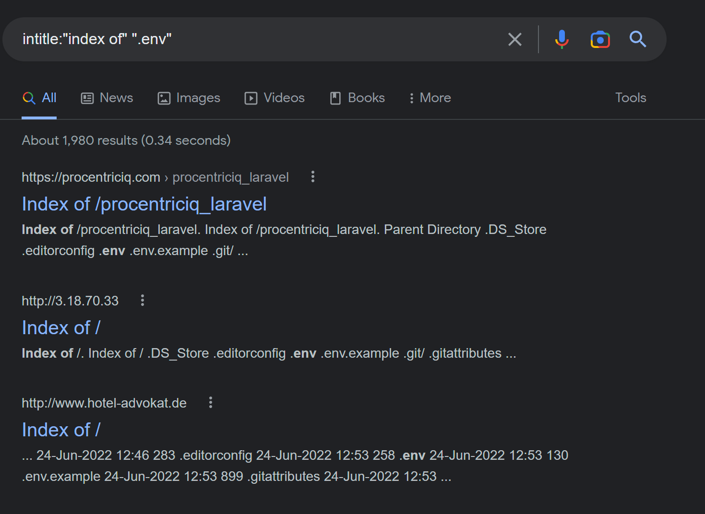
Google Dorks
Google Dorks are using google’s built in search keywords such as intext: and intitle: to refine the searches, allowing you to find things that are indexed by Google’s web crawler that probably shouldn’t be.
Common Dorks include:
Site: - Restricts search to a specific site
Type: - Restricts search to a specific file type
Intitle: - Ensures that the following text is in the title
Intext: - Ensures that the following text is in the content
Logical operators can also be used to give more variety to results, such as AND OR and NOT.
These help to better define search results.
A list of google dorks used for hacking can be found on exploitDB
https://www.exploit-db.com/google-hacking-database

Slide 7
Reverse Image Searching
Yandex is a russian search engine that provides similar services to Google.
Yandex’s reverse image search can perform better than Google’s so it is recommended to use Yandex for reverse image searching.
Google Images also has its own reverse image search. Google, being an american company, may be preferred by certain organisations. As a result it is a good idea to be familiar with both.

Slide 8



Social Media
LinkedIn is a social media site aimed at making business connections and as a result is a treasure trove for information. LinkedIn posts can give a lot of information about a company and is used by competing companies to guess the pitching style of competing marketing teams. Also people post where they are working on LinkedIn allowing malicious actors to easily find employees at a company.
If you have seen Jordon’s likes on Twitter then you can understand how much information about a person’s interests can be found through their twitter profile.
Oi!!!

Slide 9

Public Government Data
The Government is required to post information that is potentially sensitive to ensure that businesses and companies can run properly. Company House is used in the UK to register a company and anyone is able to look it up to see where the company is based from. This is usually a home address for the person running the company if it’s a sole trader or startup company.
Telephone directories and the electoral roll are public information that can be accessed by anyone. These contain sensitive information such as people’s home address
Under the freedom of information act, the government are required to release certain information about their activities.

Slide 10



Registries
The Electoral roll is a database of everyone that is able to vote in the UK. It contains their full name and address. Companies have commercialised this information with services that allow you to check co-occupants, previous addresses and even house prices for only a few pounds. 192.com can be used to search the electoral roll
The Phone book can be used to find people’s phone numbers. Yell.com is used in the UK and is an online version of the yellow pages phone book. Whitepages.com is used in the US and contains additional information such as addresses and other occupants.
Websites such as ancestry allow the searching of birth, marriage and death records. These can reveal people’s full name along with place of birth etc and can be very useful when researching people.

Slide 11

Professional and academic Publications
Professional and academic articles are useful for gathering information on how something works. This could lead to exploit discovery for a specific version of software, allowing you to compromise the system much easier.
Academic research into how things work could also give you an upper hand when red teaming as you could find an exploit based on a quirk in some hardware or even find new ways to exfiltrate data from air-gapped systems.

Slide 12
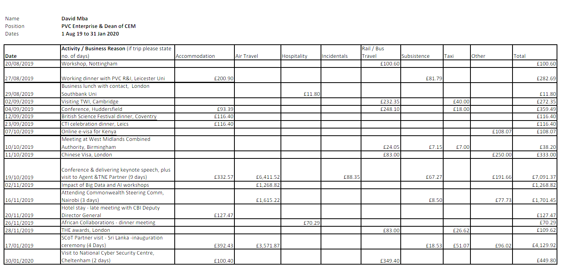
Commercial Data
Commercial data such as financial and industrial data can be leveraged to understand how the company operates and allows you to analyse their purchases to help you better understand their role.

Slide 13
Grey Literature
Grey Literature consists of technical documentation such as reports and patents. This could be used to gain a greater understanding of the hardware and or software and often leaks upcoming releases as patents need to be made before announcements.
Newsletters from companies also count and these often contain upcoming events and can sometimes even break company news to the public.

Slide 14
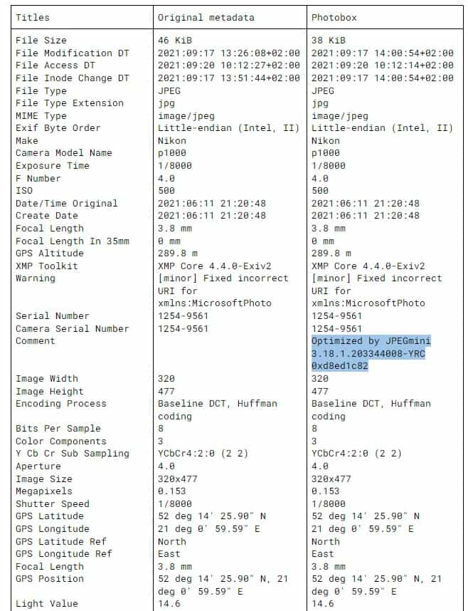
Metadata
Images contain information in the metadata of the file that stores information such as which camera took the photo as well as the GPS data if it is enabled on the device. Social media services have forgotten to strip this data which can cause someone’s address to be leaked just by sending a picture. Discord recently had a bug in their new video uploading process which meant that the metadata was kept on any video uploaded.
Exif, a tool on kali, can be used to extract this information.

Slide 15
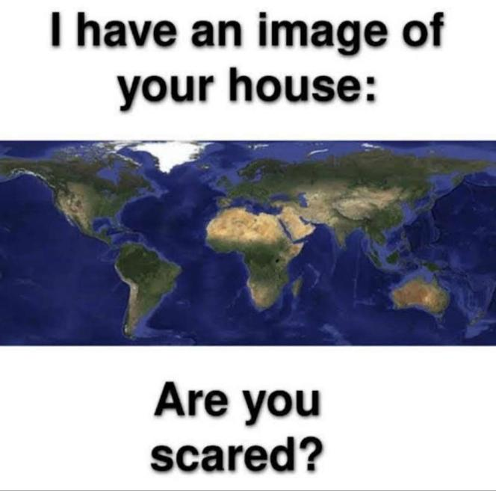
People OSINT
(not stalking)
Put simply, using the information people post about themselves (or not in some cases) to find out more about them.

Slide 16
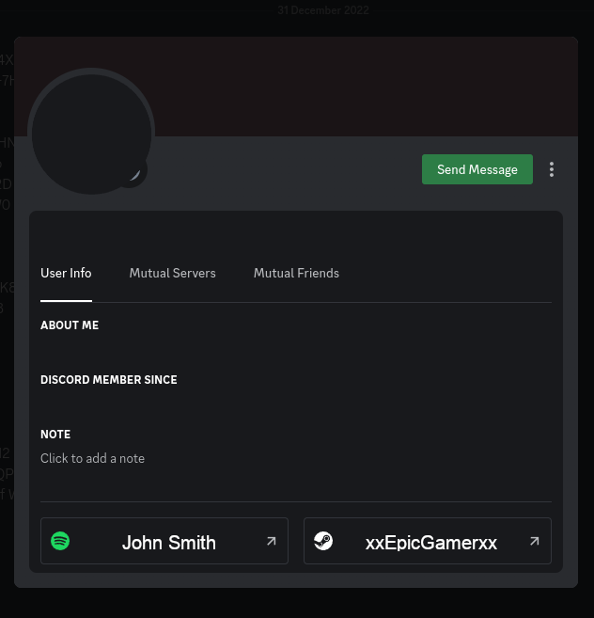
People OSINT
(not stalking)
Linking accounts
Usernames
Searching for other accounts using their usernames
https://whatsmyname.app/
Remember to try variations of the username
JDN, JDN_, JDNx, JDN-
SkyzerFlyzer, Skyzer_Flyzer
Finding old usernames
https://namemc.com
Steam
Discord
Linked accounts
Spotify (people like to put their real names here)
Steam (as above can help find old usernames)

Slide 17
People OSINT
(not stalking)
(i promise)
Finding information
Twitter
Pictures and text to harvest
Instagram
Same
Sometimes instagram is tagged with locations
Youtube
Old youtube accounts by silly children may have videos to geolocate with
Further account linking with the channels feature and socials feature on the banner
Facebook
Tells all
Remember who their friends are
If a name/username keeps popping up on multiple accounts they are likely a close friend
You can be as locked down as you want, but if your friends aren’t then we can find out stuff about you through them.

Slide 18
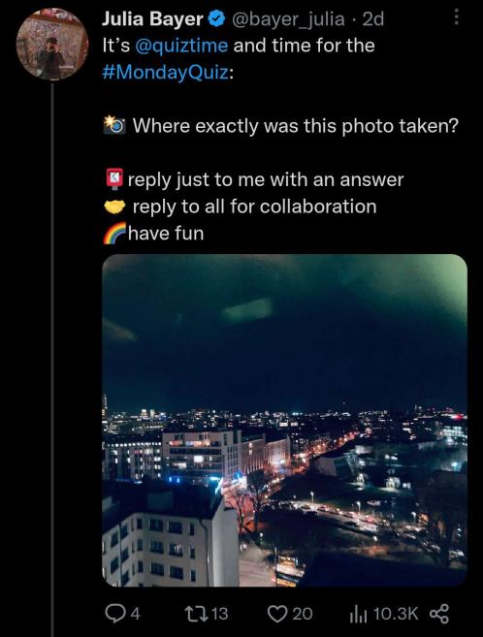
People OSINT
(not stalking)
(i promise)
Geolocation
Using images people have posted of themselves or their surroundings to help with location.
Use things in the image
Yandex might know the location
If there’s any text (e.g street signs) put it through google lens or google translates image scan
Finding similarities in pictures to see if they’re just on holiday or in their standard residence
Narrow it down by things they say or have in their bio.
People Search
Phonebooks
https://www.thephonebook.bt.com/
Census results
https://www.192.com/people/search/
https://twitter.com/bayer_julia

Slide 19
Practical
All task images can be found in week_19/tasks on the hackers Github (In weekly sessions)
What camera was used to take task_01.jpg?
What town was task_01.jpg taken in?
What is the name of the road task_01.jpg was taken on?
What is the name of the hill task_02.jpg was taken on?
What is the name of the town in task_02.jpg?
What street is task_03.jpg taken on?
What is the name of the unusually busy bar in task_03.jpg
Which city was task_04.jpg taken in?
What is the name of the street the ice cream van in task_04.jpg is located on?
Where is task_05.jpg taken
Where is task_06.jpg taken?
Where was the person, the statue in task_06.jpg was dedicated to, born?
Where was task_07.jpg taken?
What is being held in task_08.jpg
What can you find out about the committee? (start at https://www.dmuhackers.com)

